Slide 1


Build-An-Agent
UNCC Association of Data Science

Slide 2
Overview
Goal
Create an AI agent that generates images from text and analyzes them using an object detection model. Gain hands-on experience with pre-trained models and learn how to integrate different machine learning pipelines effectively.

Slide 3
Overview
Agenda
Overview of AI agents and pipelines
Walkthrough of an AI Agent that creates and detects images
Discussion
Try the agent yourself!

Slide 4
What is an AI Agent?
Definition: An AI agent is a system that autonomously perceives, decides, and acts to achieve goals, not just LLMs controlling tools.
Real-Life Examples
Autonomous robots
Smart assistants that chain multiple tools
Recommendation systems that adapt to feedback
Game-playing AIs that develop strategies

Slide 5
What is Agentic AI?
Definition: Agentic AI make decisions, take actions, and even learn on its own to achieve specific goals. It’s kind of like having a virtual assistant that can think, reason, and adapt to changing circumstances without needing constant direction
Real-Life Examples
Self-Driving Cars
Analyzing medical data, identifying patterns and helping doctors make more informed decisions

Slide 6
AI Agent vs Agentic AI
AI Agent
Agentic AI
completes tasks
works with humans to complete goals
can generate images, send emails, draft emails
completes goals independently
can work with external systems
sets its own tasks based on goals

Slide 7
Pipelines in AI
Definition: A sequence of steps or stages through which data flows, and each stage performs a specific operation or transformation on the data
Used to automate or streamline the process of data processing, model training, and inference for reproducible workflows

Slide 8
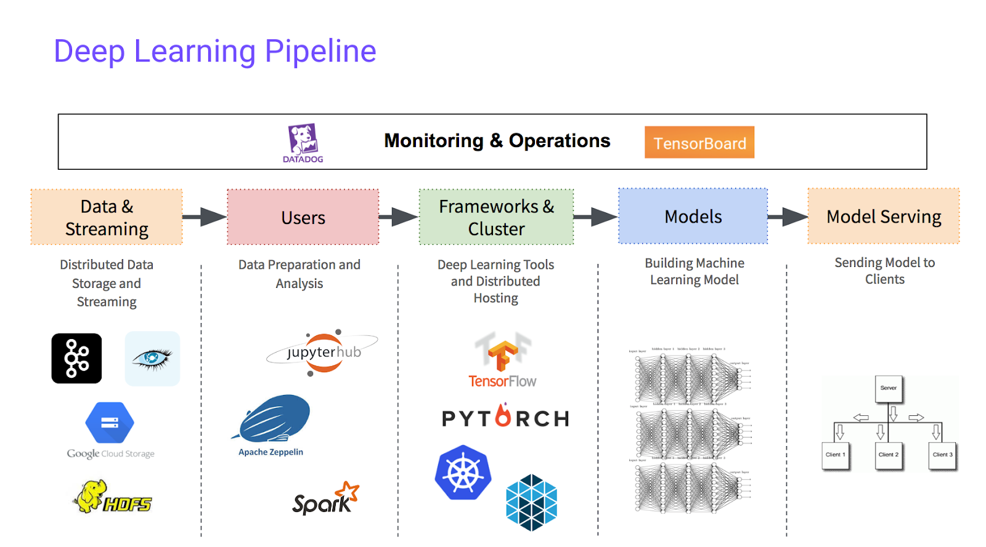
Pipelines in AI

Slide 9
Our AI Agent
Image Generation (Stable Diffusion)
Uses StableDiffusionPipeline to generate images from text prompts.
Supports negative prompts, adjustable inference steps, and guidance scale.
Saves generated images in a specified directory.
Object Detection
Uses a pre-trained Hugging Face object-detection pipeline.
Detects objects in images and outputs their labels & confidence scores.
Can visualize detections by drawing bounding boxes on images.
LLM Integration (Optional)
Uses Llama 2 or other transformer-based models for natural language processing.
Enhances image prompts for better Stable Diffusion outputs.
Analyzes detected objects in an image and provides insightful descriptions.
Implements GGML quantized model support for optimized performance.

Slide 10
Additional Resources
Agentic AI/AI Agents
https://medium.com/@elisowski/ai-agents-vs-agentic-ai-whats-the-difference-and-why-does-it-matter-03159ee8c2b4

